Slide 1
Digital Logic Design I CS1026
Paula.Roberts@scss.tcd.ie

Slide 2
A
X
The Inverter
The inverter performs the Boolean NOT operation. When the input is LOW, the output is HIGH; when the input is HIGH, the output is LOW.
LOW (0) HIGH (1)
HIGH (1) LOW(0)
The NOT operation (complement) is shown with an overbar. Thus, the Boolean expression for an inverter is X = A.

Slide 3
A
X
The Inverter
Example waveforms:
A
X
A group of inverters can be used to form the 1’s complement of a binary number:
Binary number
1 0 0 0 1 1 0 1
0 1 1 1 0 0 1 0
1’s complement

Slide 4
A
A
The AND Gate
X
X
B
B
The AND gate produces a HIGH output when all inputs are HIGH; otherwise, the output is LOW. For a 2-input gate, the truth table is
0 0
0 1
1 0
1 1
0
0
0
1
The AND operation is usually shown with a dot between the variables but it may be implied (no dot). Thus, the AND operation is written as
X = A .B or X = AB.

Slide 5
A
A
The AND Gate
X
X
B
B
Example waveforms:
A
B
X
The AND operation is used in computer programming as a selective mask. If you want to retain certain bits of a binary number but reset the other bits to 0, you could set a mask with 1’s in the position of the retained bits.
Example
If the binary number 10100011 is ANDed with the mask 00001111, what is the result?
00000011

Slide 6
The OR Gate
A
X
A
X
B
B
The OR gate produces a HIGH output if any input is HIGH; if all inputs are LOW, the output is LOW. For a 2-input gate, the truth table is
0 0
0 1
1 0
1 1
0
1
1
1
The OR operation is shown with a plus sign (+) between the variables. Thus, the OR operation is written as X = A + B.

Slide 7
The OR Gate
A
X
A
X
B
B
Example waveforms:
A
B
X
The OR operation can be used in computer programming to set certain bits of a binary number to 1.
Example
ASCII letters have a 1 in the bit 5 position for lower case letters and a 0 in this position for capitals. (Bit positions are numbered from right to left starting with 0.) What will be the result if you OR an ASCII letter with the 8-bit mask 00100000?
Solution
The resulting letter will be lower case.

Slide 8
A
X
A
X
The NAND Gate
B
B
The NAND gate produces a LOW output when all inputs are HIGH; otherwise, the output is HIGH. For a 2-input gate, the truth table is
0 0
0 1
1 0
1 1
1
1
1
0
The NAND operation is shown with a dot between the variables and an overbar covering them. Thus, the NAND operation is written as X = A .B (Alternatively, X = AB.)

Slide 9
A
X
A
X
The NAND Gate
B
B
Example waveforms:
A
B
X
The NAND gate is particularly useful because it is a “universal” gate – all other basic gates can be constructed from NAND gates.
Question
How would you connect a 2-input NAND gate to form a basic inverter?

Slide 10
The NOR Gate
A
X
A
X
B
B
The NOR gate produces a LOW output if any input is HIGH; if all inputs are HIGH, the output is LOW. For a 2-input gate, the truth table is
0 0
0 1
1 0
1 1
1
0
0
0
The NOR operation is shown with a plus sign (+) between the variables and an overbar covering them. Thus, the NOR operation is written as X = A + B.

Slide 11
The NOR Gate
A
X
A
X
B
B
Example waveforms:
A
B
X
The NOR operation will produce a LOW if any input is HIGH.
Example
When is the LED is ON for the circuit shown?
Solution
The LED will be on when any of the four inputs are HIGH.

Slide 12
The XOR Gate
A
X
A
X
B
B
The XOR gate produces a HIGH output only when both inputs are at opposite logic levels. The truth table is
0 0
0 1
1 0
1 1
0
1
1
0
The XOR operation is written as X = AB + AB. Alternatively, it can be written with a circled plus sign between the variables as
X = A + B.

Slide 13
The XOR Gate
A
X
A
X
B
B
Example waveforms:
A
B
X
Notice that the XOR gate will produce a HIGH only when exactly one input is HIGH.
Question
If the A and B waveforms are both inverted for the above waveforms, how is the output affected?
There is no change in the output.

Slide 14
The XNOR Gate
A
X
A
X
B
B
The XNOR gate produces a HIGH output only when both inputs are at the same logic level. The truth table is
0 0
0 1
1 0
1 1
1
0
0
1
The XNOR operation shown as X = AB + AB. Alternatively, the XNOR operation can be shown with a circled dot between the variables. Thus, it can be shown as X = A . B.

Slide 15
The XNOR Gate
A
X
A
X
B
B
Example waveforms:
A
B
X
Notice that the XNOR gate will produce a HIGH when both inputs are the same. This makes it useful for comparison functions.
Question
If the A waveform is inverted but B remains the same, how is the output affected?
The output will be inverted.

Slide 16
Fixed Function Logic
Two major fixed function logic families are TTL and CMOS. A third technology is BiCMOS, which combines the first two. Packaging for fixed function logic is shown.
Dual in-line (DIP) package Small outline (SOIC) package

Slide 17
Fixed Function Logic
Some common gate configurations are shown.

Slide 18
Fixed Function Logic
Logic symbols show the gates and associated pin numbers.

Slide 19
Fixed Function Logic
Data sheets include limits and conditions set by the manufacturer as well as DC and AC characteristics. For example, some maximum ratings for a 74HC00A are:

Slide 20
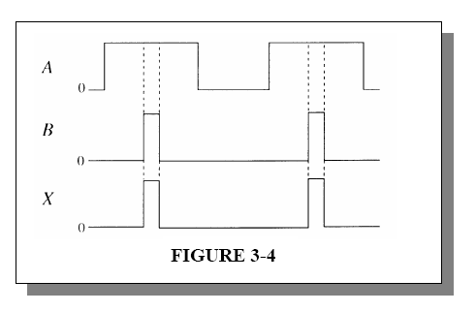
Examples
Signal A and B are applied to a 2 i/p AND Gate. What is the o/p X

Slide 21
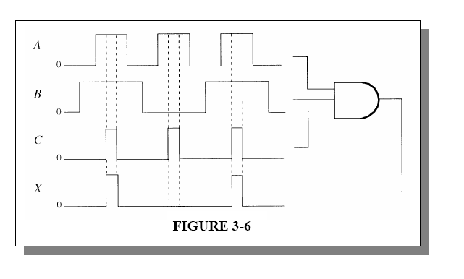
Examples
Signals A, B and C are applied to a 3 i/p AND Gate. What is the o/p X

Slide 22
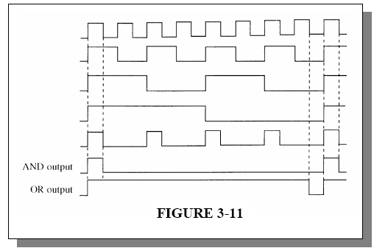
Examples
For the 5 i/p waveforms shown determine the o/p if the 5 signals are ANDed. Determine the o/p if the 5 signals are ORed.

Slide 23
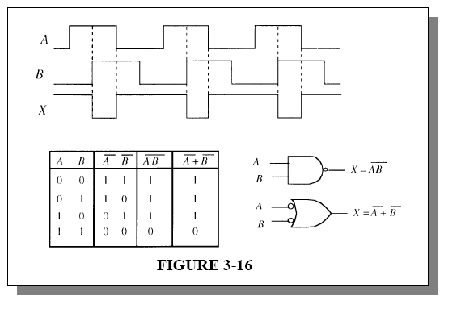
Examples
Show that the o/p from the two gates shown are identical for the i/ps A and B

Slide 24
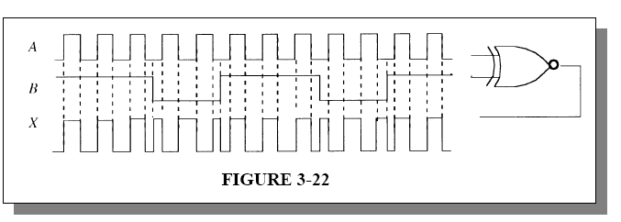
Examples
Show that the o/p from the XNOR is as shown for the i/ps A and B

